Slide 1
Quinn Research Group Meeting
September 5, 2018

Slide 2
A Probabilistic Approach to Joint Cell Tracking and Segmentation in High-Throughput Microscopy Videos
Authors: Assaf Arbelle, Jose Reyes, Jia-Yun Chen, Galit Lahav, Tammy Riklin Raviv
Department of Systems Biology, Harvard Medical School
Department of Electrical and Computer Engineering, Ben-Gurion University of the Negev, Israel
The Zlotowski Center for Neuroscience, Ben-Gurion University of the Negev, Israel

Slide 3
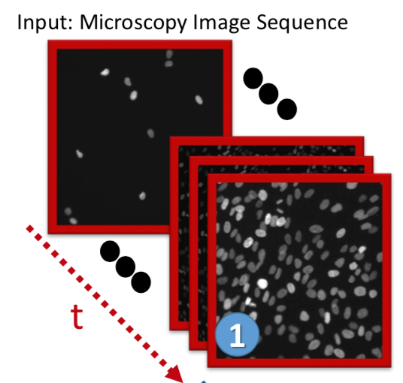
Highlights
Authors propose an unsupervised tracking and segmentation framework for microscopy videos
Problems of segmenting and tracking cells are handled simultaneously using Bayesian inference of dynamic models
Very little ground-truth is needed, and cells are not assumed to be any particular shape
State-of-the-art performance, blah blah blah

Slide 4
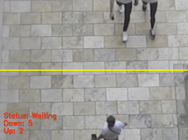
Segmentation & Tracking
Two distinct but related ideas in computer vision
Object segmentation entails finding “boundaries” of objects in images
Object tracking means not only identifying objects, but recognizing the same ones across time
Both are challenging!
This paper does both, jointly (one helps the other)

Slide 5
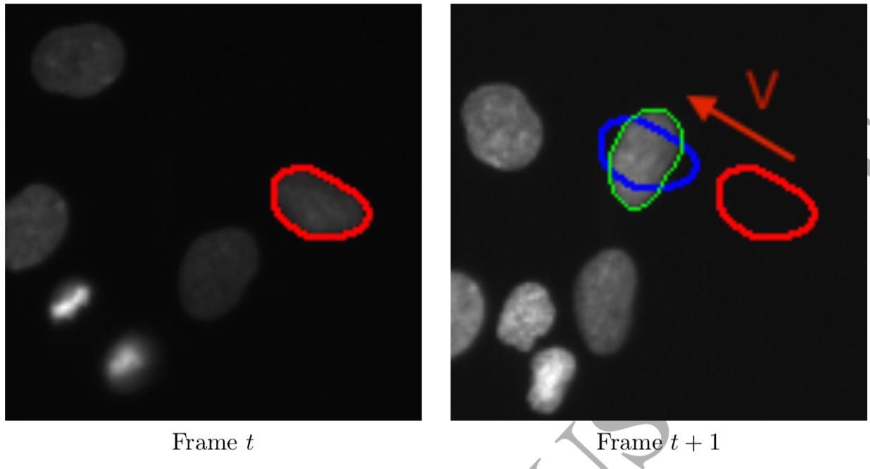
Segmentation & Tracking
This paper does both, jointly
Motion estimation, a la Kalman Filter
Probabilistic assignment of pixels to a cell
Segmentation in frame t+1 is a function of
Segmentation in frame t
Motion estimation in frame t+1
Use Kalman state vector to build a “shape prior” for each cell
Use a fast-matching algorithm to probabilistically align cells over frames

Slide 6
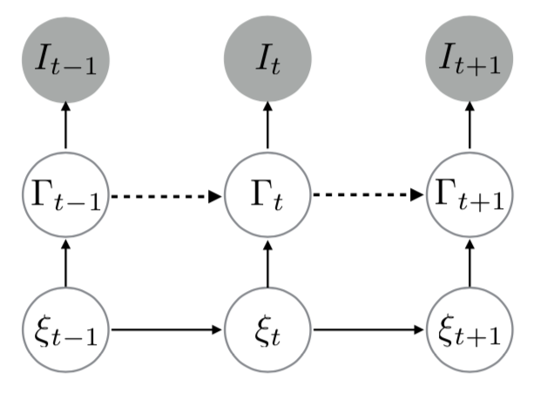
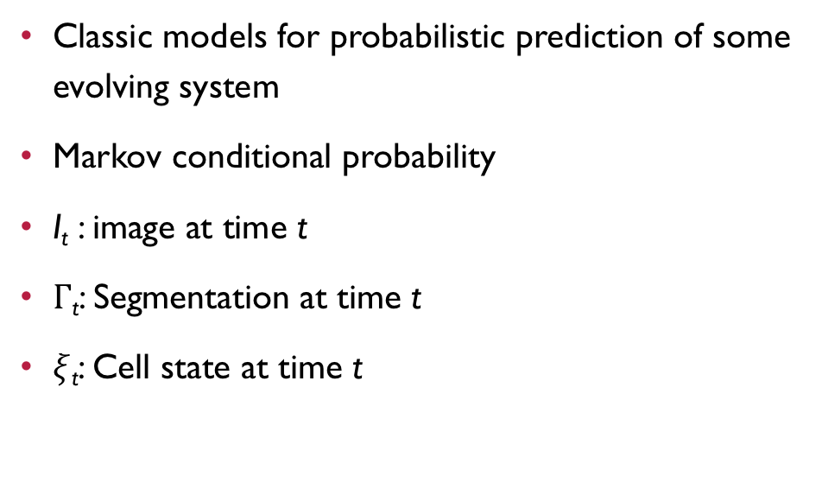
Kalman Filters
Classic models for probabilistic prediction of some evolving system
Markov conditional probability
I_{t} : image at time t
$Γ$_{t}: Segmentation at time t
$ξ$_{t}: Cell state at time t
Known
Unknown
Unknown

Slide 7
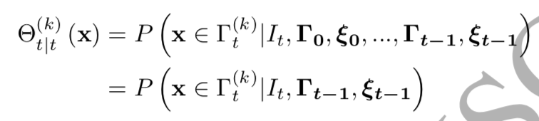
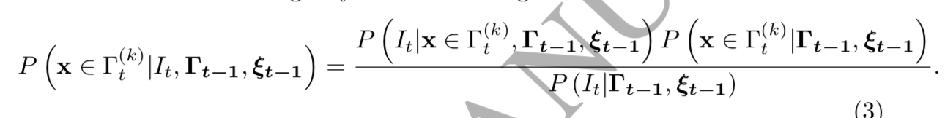
Probabilistic Model of Assigning One pixel to a cell
Markov Assumption
Bayes’ Theorem
Notes:
Probability of pixel x belonging to cell k at time t

Slide 8
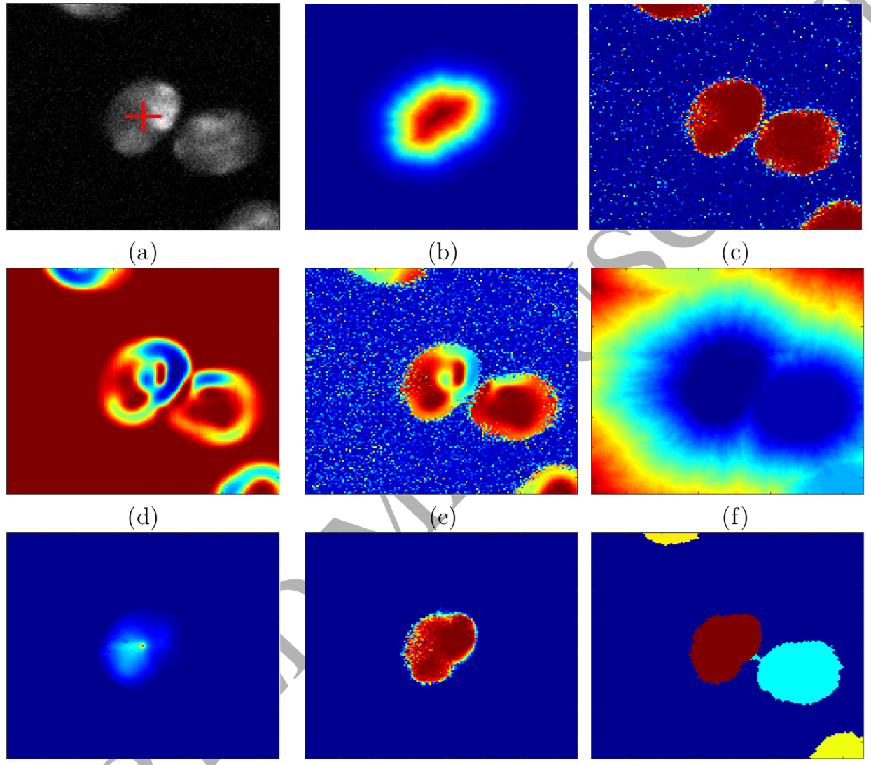
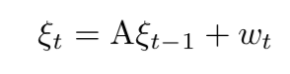
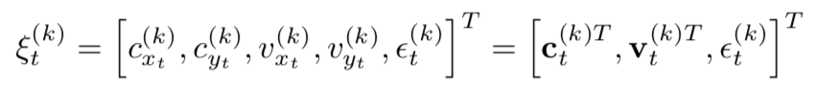
Kalman State Vector
Notes:
Center of mass, velocity, and shape uncertainty
A: original image, with center of mass (estimated) as red cross
B: spatial prior probability
C: intensity probability of foreground
D: image gradient
E: product of c and d (speed image)
F: fast-matching distance
G: likelihood
H: posterior
I: MAP-based labeled segmentation

Slide 9
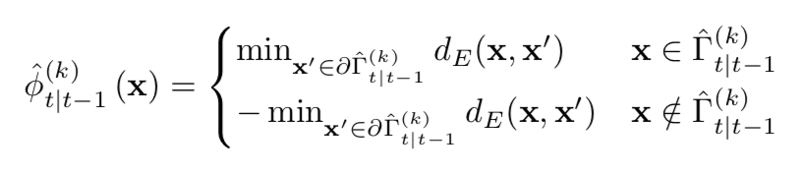
Signed Distance function
This is the dynamic shape model (DSM), which is the “shape prior” used for segmentation over time
Basically, tries to give pixels inside the cell positive distance values, and pixels outside the cell negative distance values
Pixel x belongs to object k
Pixel x does NOT belong to object k
Some pixel on the estimated segmentation boundary
Euclidean distance

Slide 10
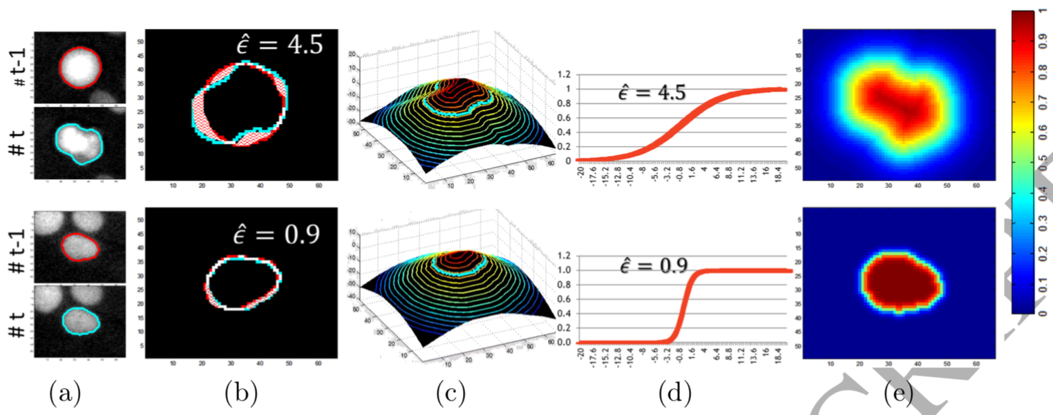
Signed Distance Function
Notes:
Data, cells in t and t+1
Superimposed prior and predicted segmentations (epsilon error is much larger in one with more uncertainty due to shape change)
Signed distance function (zero-level is the original contour)
Logistic function with SDF in the exponential numerator
Resulting dynamic shape model (DSM), the cell’s probability map (fuzzier edges with more uncertainty)

Slide 11
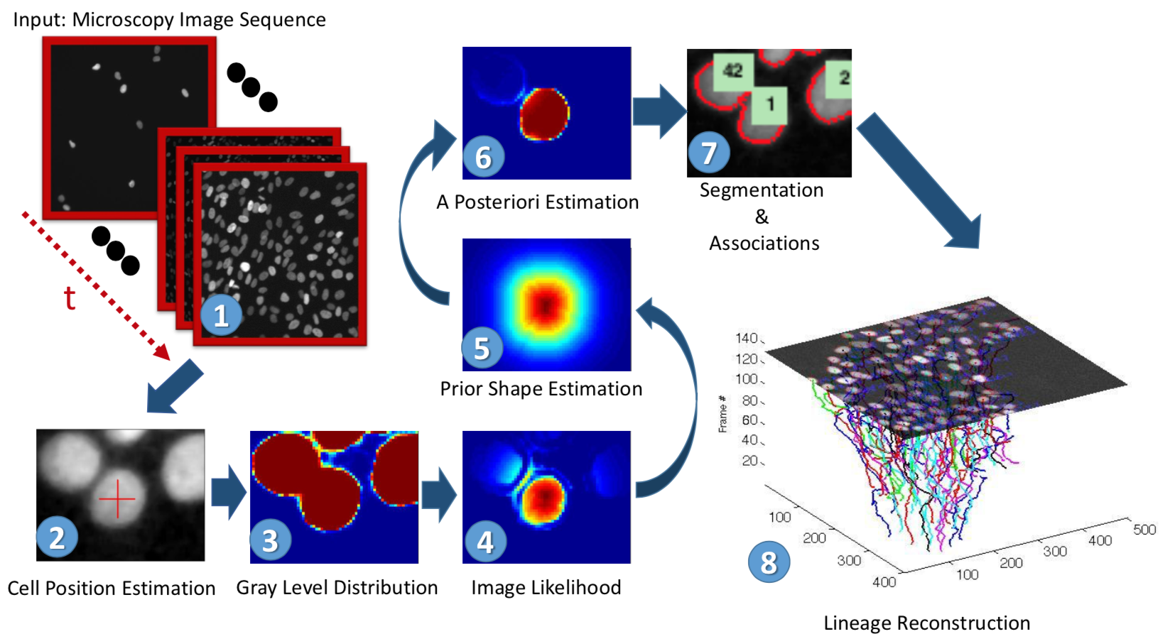
Pipeline

Slide 12
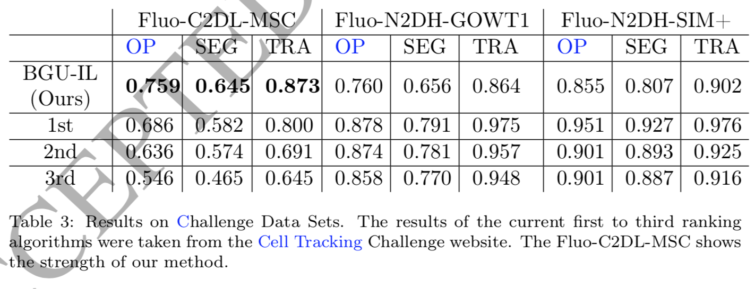
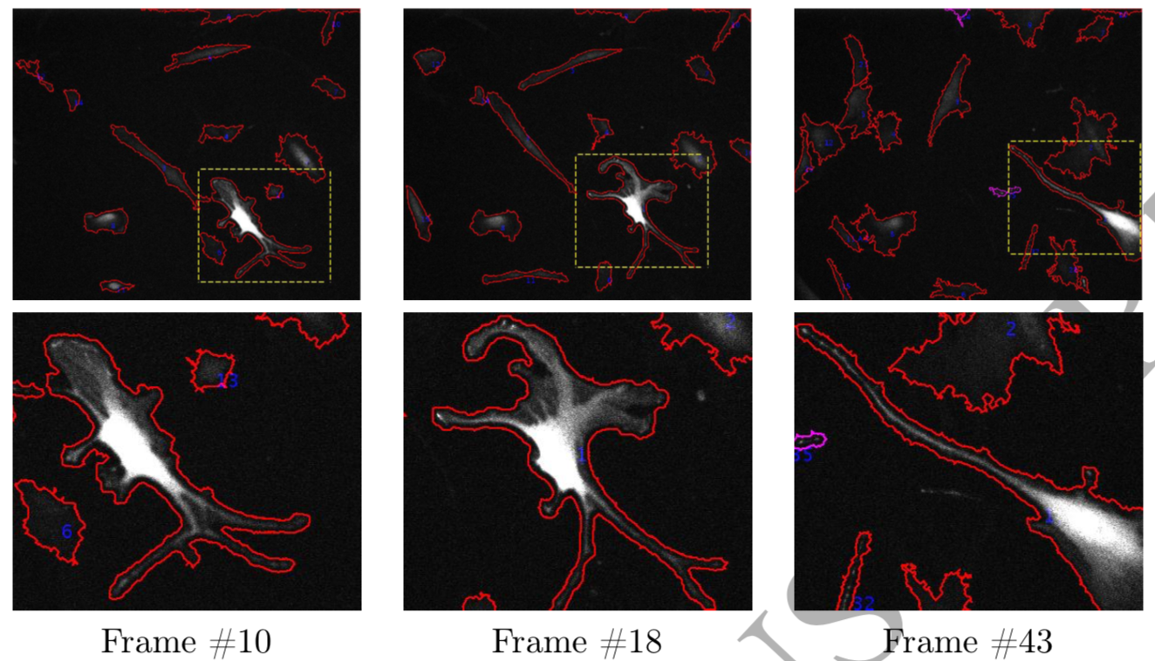
Experiments
Tested out the algorithm against openly available Cell Tracking Challenge datasets

Slide 13
Conclusions
Probabilistic algorithm for [mostly] unsupervised object detection and tracking
Works irrespective of cell shape (i.e., does not need to be circular)
Achieves excellent results on open benchmark datasets
Very elegant and well-designed theoretical model
Scalability is untested (struggles with longer videos)
Unclear if fast-matching algorithm leads to incorrect segmentations
Had difficulty with datasets lacking contrast, mitotic events, overlapping cells
Requires an initial segmentation “seed”

Slide 14
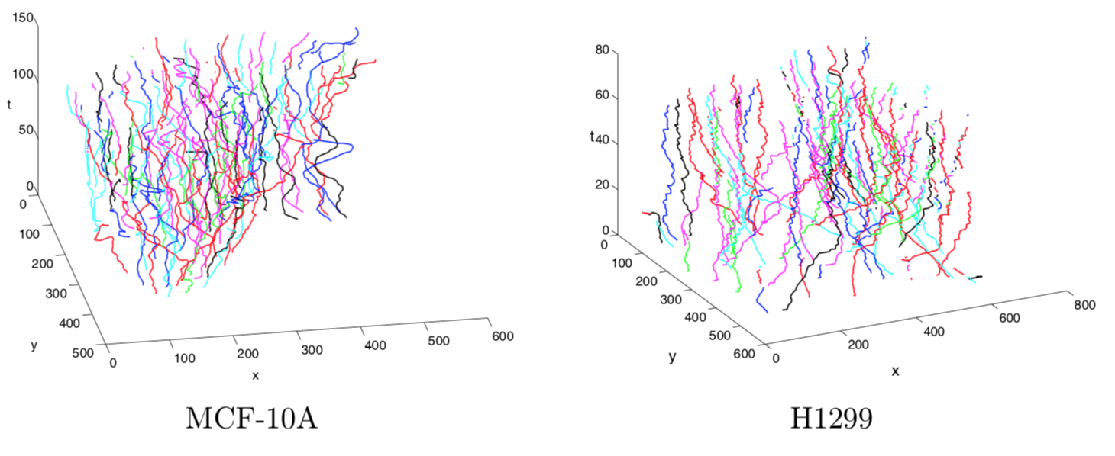
Questions?
https://github.com/arbellea/CellTrackingAndSegmentationPublic

Slide 15
And now for something completely different

Slide 16
Group Members
Roi Ceren (Ph.D.)
Mojtaba Fazli (Ph.D.)
Bahaa AlAila (Ph.D.)
Rajeswari Sivakumar (M.S.; remote)
Christian McDaniel (M.S.)
Weiwen Xu (M.S.)
Andrew Durden (B.S. turned M.S.)
Zane Page (B.S.)
Sy Ahmed (B.S.; “remote”)
Andrew Bennett (B.S.)
Sonia Rao (B.S.)
Meekail Zain (B.S.)

Slide 17
Group Members
Roi Ceren (graduating!)
Mojtaba Fazli
Bahaa AlAila
Rajeswari Sivakumar (graduating!)
Christian McDaniel
Weiwen Xu
Andrew Durden
Zane Page
Sy Ahmed (graduating!)
Andrew Bennett
Sonia Rao
Meekail Zain

Slide 18
Fall 2018 Schedule
September 5 (today)
September 19: Andrew Durden
September 26: Christian McDaniel
October 10: Mojtaba Fazli
October 17: Roi Ceren
October 24: Bahaa AlAila
October 31: Weiwen Xu
November 7: Zane Page & Meekail Zain
November 14: Sonia Rao & Andrew Bennett
November 21:
December 13(ish)
Notes:
March 14: spring break!
April 4: Both ISBI in D.C., and I’m on a Lilly Fellow retreat in North GA
April 11: AnacondaCON in Austin, TX
Emphasis:
- Mojtaba (practice for ISBI)
- Roi (practice for defense)
- Charles (practice for SDSC, ISBI, & others)
- Raj (practice for SDSC, SciPy, & others)

Slide 19
Expectations
Excellence in Research
Clear objectives (set goals)
Self-motivation (keep trying things)
Collaboration (talk to each other)
Continued progress (even sideways)
Excellence in Communication
Writing & Editing (preprints, papers)
Blogging
Documenting (in-code, READMEs, wikis)
Open Science (group GitHub)

Slide 20
Resources
Codename “LittleJohn”
20 nodes: 12 cores, 128GB memory, 2TB HDD each
1 node: 12 cores, 16GB memory, 40TB HDD
1 node: 2x TITAN GPU
Google Cloud Platform ($300 free for signing up!)
Amazon Web Services (currently no research credits, sorry ☹ )
GACRC: https://wiki.gacrc.uga.edu/wiki/Main_Page
I have a lab account—let me know if you want/need access, and I’ll sign you up

Slide 21
Conference Venues
Interested in traveling? Practice speaking in front of a crowd? A chance to network with the experts?

Slide 22
Conference Venues
ACM SIGKDD
KDD 2018 was in London, England last month
Tippy-top data science conference
Submission deadline usually ~February
http://www.kdd.org/kdd2018/

Slide 23

Conference Venues
International Conference on Machine Learning
Long Beach, CA
June 10-15, 2019
Submission deadline in ~January
https://icml.cc/

Slide 24

Conference Venues
MICCAI
Granada, Spain
Will be September 16 - 20, 2018
Submission deadline usually ~February
Also lots of A+ workshops with submission deadlines in the summer months
http://www.miccai2018.org/

Slide 25
Conference Venues
SciPy
Always in Austin, Texas
SciPy 2018 was July 9 – 15
Abstract deadline usually ~February
https://scipy2018.scipy.org/
Had two papers accepted to SciPy 2018!

Slide 26
Conference Venues
IEEE International Symposium on Biomedical Imaging (ISBI)
Venice, Italy
April 8-11, 2019
Submission deadline: October 9, 2018
https://biomedicalimaging.org/2019
~20% acceptance rate
Had two papers and a poster accepted to ISBI 2018!

Slide 27
Conference Venues
Southern Data Science Conference 2019
Atlanta, GA
April 11-13, 2019
Abstracts probably due ~January
https://www.southerndatascience.com/
Had two posters accepted to SDSC 2018!
(Full disclosure: I’m on the SDSC Advisory Board)

Slide 28

Conference Venues
CVPR
Long Beach, CA
June 15 – 21, 2019
Submission deadline: November 16, 2018
http://cvpr2019.thecvf.com/
Acceptance rate: ~30%
Most likely great workshops with ~early-to-mid spring deadlines

Slide 29
Conference Venues
Open Science in Big Data (OSBD) Workshop
Seattle, WA
December 10 – 13, 2018
Submission deadline: October 19, 2018
https://osbd.github.io/2018/
Acceptance rate: ~50%
Part of the IEEE BigData Conference, arguably the top “big data” venue in the world
(Full disclosure: I’m the OSBD chairperson)

Slide 30
Journals and preprints
Go through multiple rounds of review, really polish your paper, which perhaps started its life as a preprint

Slide 31
Journals
The Journal of Open Source Software (JOSS) (http://joss.theoj.org/ )
eLife
IEEE
Biomedical and Health Informatics (3.451)
Neural Networks and Learning Systems (6.108)
Image Processing (4.828)
Medical Imaging (3.942)
Computational Biology and Bioinformatics (1.955)
ACM
Knowledge Discovery from Data
Computational Biology and Bioinformatics
PLoS
ONE
Computational Biology
PeerJ
Computer Science
Preprint

Slide 32
Preprint servers

Slide 33
What to do next

Slide 34
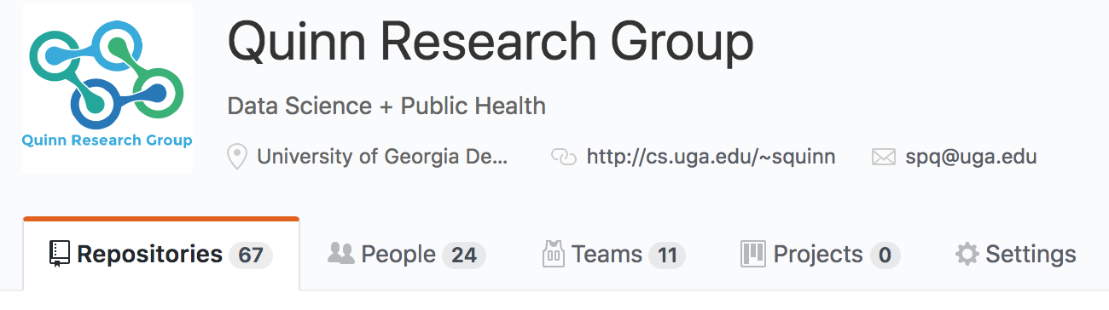
Connect to the QRG Github
Send me your GitHub username

Slide 35
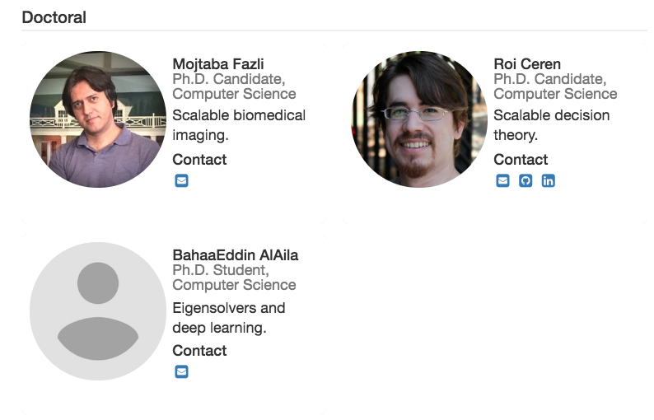
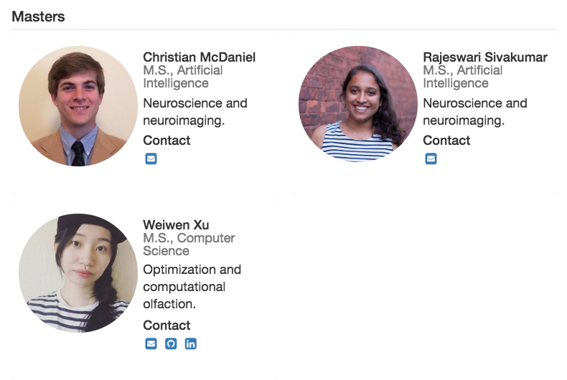
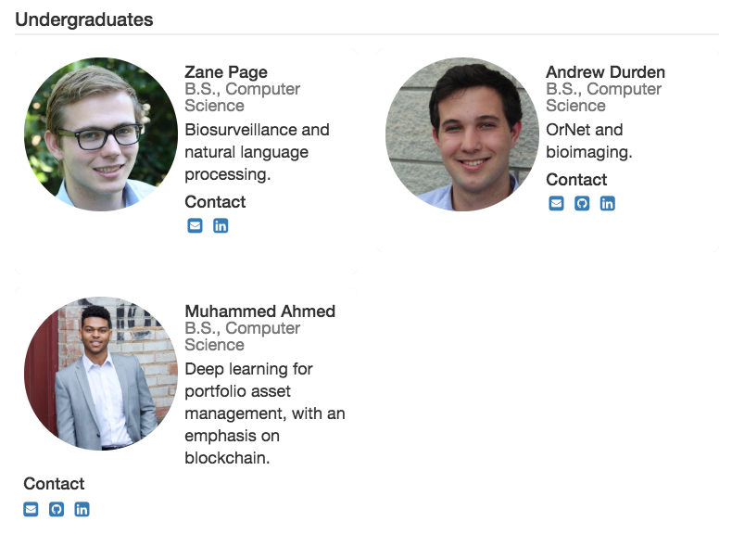
Pictures + Info
https://quinngroup.github.io/people.html
Email address, GitHub, social network handles, etc

Slide 36
When it’s your turn to give a talk
(yep, we’re putting presentation materials on GitHub now!)
Clone the repository
Go into the folder for the proper year (so for you, this would be 2018)
Create a new folder there in the format: <month><day>_<name>_<summary>
Create a README file with a summary of your talk
Include all the materials (pptx, paper, notebooks, etc) in that folder (NOT raw data though)
From inside that directory: add, commit, and push everything back out!

Slide 37
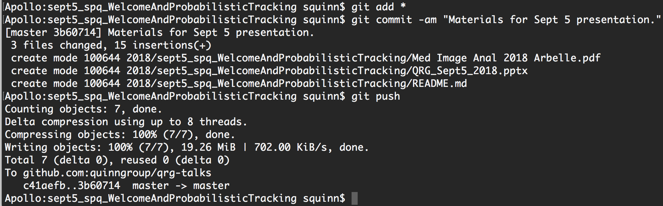
When it’s your turn to give a talk

Slide 38
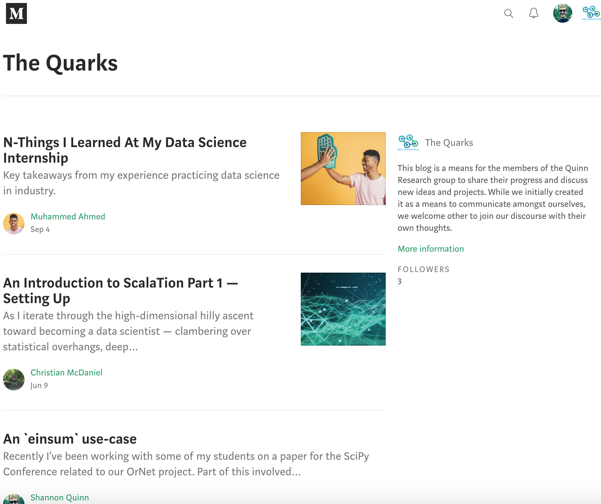
Sometime this semester
Publish a blog post on our “Quarks” Medium account! https://medium.com/the-quarks
Can be on anything!
A particularly tricksy bit of code you labored over (that’s basically what my “einsum use-case” post is about)
Some software you used (that’s Christian’s post)
Lessons learned from a conference, meetup, internship, or other event (Sy’s recent post)
A cool paper you came across
[YOUR IDEA HERE]
Award for the most-shared blog post!
Draft the post, & pass it around for editing, proofreading, and suggestions!

Slide 39
Every Saturday or Sunday
Send me a message over Slack or email with the following bits of information:
What you accomplished in the past week
Any roadblocks you ran into or problems you had with #1
What you plan on doing in the coming week
I’ll try to remind everyone, but please take it upon yourself to do this!
I refer to these points in our individual meetings each week

Slide 40
Always
Push your code to GitHub
Document everything
Make a good README
Include comments in your code
Use the ticket system when you run into problems or need to remind yourself to do something, or even when you just get a crazy idea
Make notes in the GitHub wiki (could later form the basis for a paper or preprint)
Ask for help when you need it
Have fun with your work--and if it’s not fun, let me know

Slide 41
Questions?

Slide 42
Old slides

Slide 43
Kaggle
https://www.kaggle.com/c/rsna-pneumonia-detection-challenge

Slide 44
Kaggle 2018 Data Science Bowl
Nuclei Segmentation
https://www.kaggle.com/c/data-science-bowl-2018
April 9: Entry deadline
Talk about tailor-made for us! ☺

Slide 45
Google Summer of Code 2018
https://summerofcode.withgoogle.com/
Participating organizations announced on Feb 12
Will move fast after that!
Student Application Period: March 12-27
Need to be familiar with potential projects before then!

Slide 46

Conference Venues
IEEE Data Science and Advanced Analytics (DSAA)
Turin, Italy
October 1-3, 2018
TBD (probably May-June 2018)
Acceptance rate: ~20%
http://www.dsaa.co/

Slide 47
Conference Venues
International Conference on Computer Vision
Venice, Italy
October 24-27, 2017
March 17, 2017
http://iccv2017.thecvf.com/

Slide 48
Conference Venues
Neural Information Processing Systems
Long Beach, CA
December 4-9, 2017
TBD (probably May), 2017
https://nips.cc/Conferences/2017
~20% acceptance rate

Slide 49
Conference Venues
The ACM Conference on Bioinformatics, Computational Biology, and Health Informatics
Boston, MA
August 21-24, 2017
April 10, 2017
http://acm-bcb.org/
~30% acceptance rate

